Slide 1


TUGAS ARSIKOM
SIAPA SAYA DAN APA DEVICE SAYA?
YUK SINI KENALAN

Slide 2

CONTENTS
01
INTRODUCTION
02
HOBBY ,ALAMAT,SUKU/RAS
03
DEVICE

Slide 3

01
INTRODUCTION

Slide 4

NAMA
JURUSAN
PRODI INFORMATIKA
RANGGA BAYU AJI PRASETYO
KULIAH
NPM
23161562027
UNIVERSITAS BHINNEKA PGRI

Slide 5
02
HOBBY,ALAMAT,SUKU/RAS

Slide 6

HOBBY
ALAMAT
PANGGUNGREJO,, KAUMAN
TULUNGAGUNG
MENGGAMBAR
SUKU/RAS
JAWA

Slide 7
03
DEVICES

Slide 8
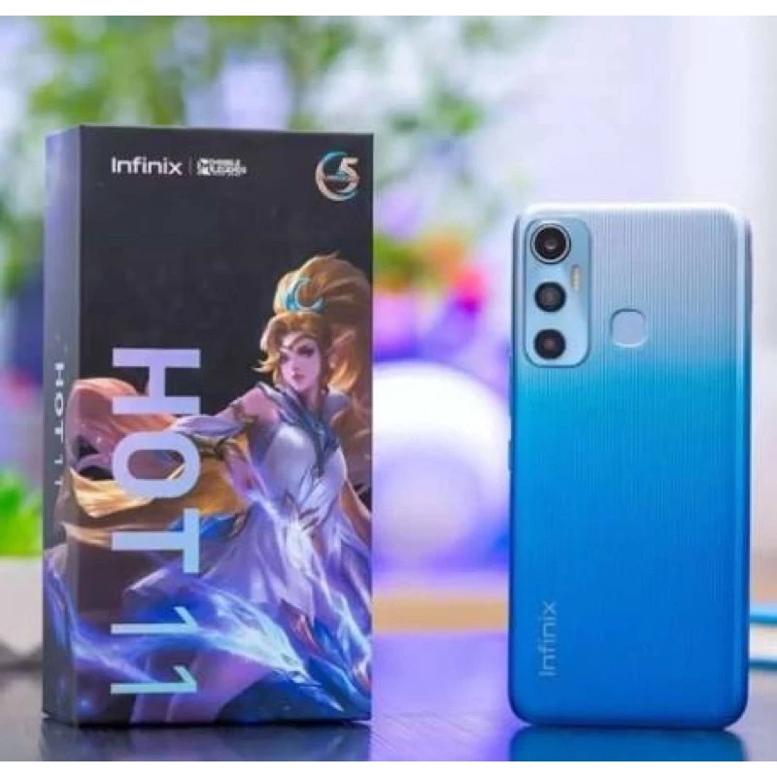
INFINIX HOT 11
PLATFORM
OS Android 11, XOS 7.6
Chipset Mediatek Helio G70 (12 nm)
CPU Octa-core (2x2.0 GHz Cortex-A75 & 6x1.7 GHz Cortex-A55)
GPU Mali-G52 2EEMC2
DISPLAY
Type IPS LCD, 500 nits (peak)
Size 6.6 inches, 104.9 cm2 (~83.6% screen-to-body ratio)
Resolution 1080 x 2408 pixels, 20:9 ratio (~400 ppi density)
MEMORY
Card slot microSDXC (dedicated slot)
Internal 64GB 4GB RAM, 128GB 4GB RAM
eMMC 5.1

Slide 9
THANK YOU

